Slide 1
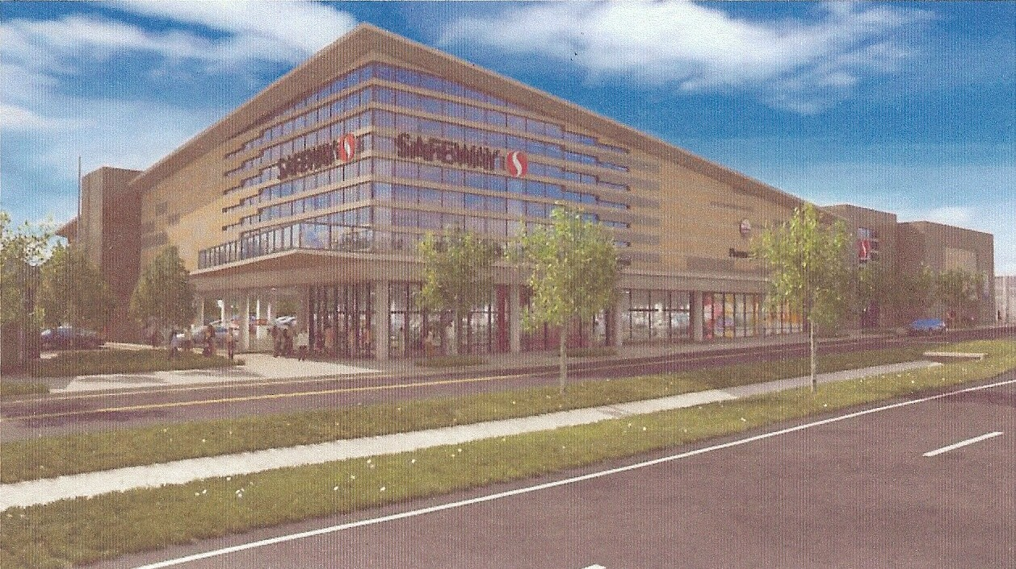
Proposal for a New Safeway Store
3526 King Street - Bradlee Shopping Center
By Nancy R. Jennings
The designer’s rendering of the King Street service road façade.
Larger than the old store by 40 percent—41,000 sq ft to 61,000 sq ft
Is raised above the parking lot (which is at ground level)
Requires DOUBLE the current FAR allowed—1.0 to 2.0
Includes a separate retail building of 3,000 sq ft (not shown above)
Will have a Bergman’s Cleaners and Starbucks inside
Will have wifi and seating for 51 people
Expects more cars daily than it has now—a traffic study indicates a 35 % increase in the number of vehicle trips during peak hours
Wants a parking reduction—only plans to increase parking by 14 %
(29 more spaces over its current 199)
Will have 2-3 Safeway delivery trucks (18-wheelers) per day
Will have additional delivery trucks per day (unknown number)
Will close off the truck access to the store from King Street
Trucks will enter and exit from West Braddock Road
Grass along King Street appears to become sidewalk
Access from Marlee Way—pedestrian and vehicle—is reduced
Safeway opposes the closure of the King Street service road between its property and the gas station that would improve the safety of pedestrians and the traffic flow on Quaker Lane through dysfunction junction
(over)

Slide 2
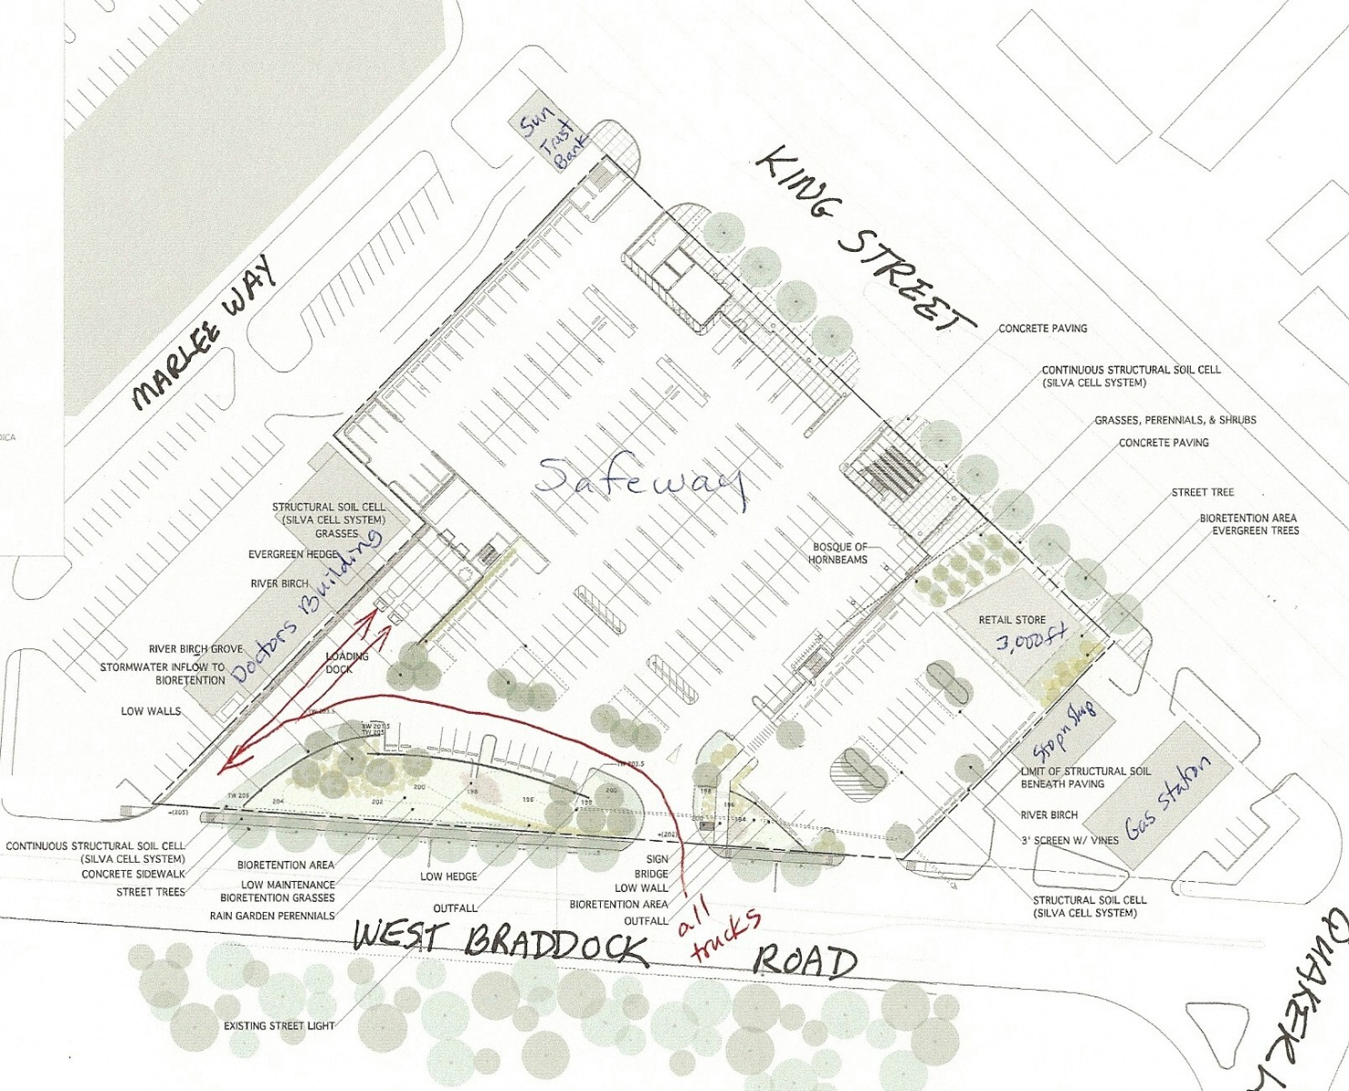
Note: The current proposal changes the location of the store’s loading docks and the access of deliver trucks to the store that likely will result in trucks queuing on West Braddock Road and in dysfunction junction. Safeway plans to close off the truck access from the King Street service road and send all trucks onto West Braddock Road. They will use the existing curb cuts: enter the store’s property via the middle curb cut (has a break in the median) and, after unloading, exit via the west curb cut (no break in the median). Because the traffic light at Marlee Way is so close to the Safeway truck exit, the option for trucks to turn left cannot be built and all trucks must turn right onto West Braddock Road and proceed toward Minnie Howard School.
Seminary Hill Association, Inc., opposes the rezoning of the Bradlee Safeway store as now proposed as a ‘Big Box’ store for a number of reasons including the delivery truck service route, the parking reduction, the increase in FAR, and the mass and scale of the project.
Approved 26 October 2011.

