Slide 1
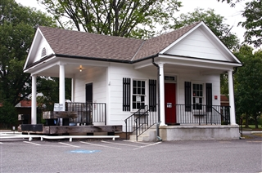
Save the Seminary Post Office . . .
. . . write to the Coordinator before Nov 21!
The small post office on Seminary Road is again on the list of post offices that may be closed as a cost saving measure. Since that operation is a profitable one—the USPS pays no rent or utilities for the VTS building and only for postal supplies, equipment, and the part-time post mistress (who would be relocated if it is closed)—the hope is that this post office can remain open. Send your thoughts and feelings about why our post office should remain open to the address below—no emails (it’s the USPS)—by November 21, 2011.
Attached for your background is the Proposal To Close the Theological Seminary VA Station and Continue To Provide Service by City Delivery.
Post Office Review Coordinator
P. O. Box 3603
Winchester, VA 22604

